Slide 1
Hewlett Packard (HP) CRM.
Prepared by : Sagarkumar Patel (300853316)

Slide 2
INTRODUCTION
HP is a technology company that operates in more than 170 countries around the world.
Stanford University classmates Bill Hewlett and Dave Packard founded HP in 1939.
The company's first product, built in a Palo Alto garage, was an audio oscillator—an electronic test instrument used by sound engineers.
One of HP's first customers was Walt Disney Studios, who purchased eight oscillators to develop and test an innovative sound system for the movie Fantasia.

Slide 3
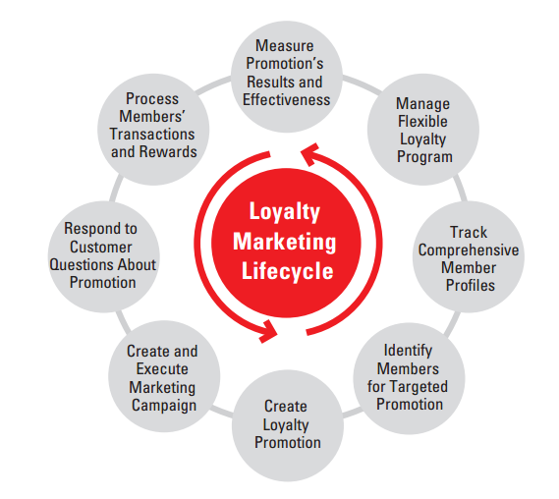
Business Model Lifecycle
Business model for marketing lifecycle.
Manage loyalty programs.
Track comprehensive member profile.
Identify Members.
Create loyalty promotions.
Executing marketing campaign.
Customers view.
Processing.
Results

Slide 4
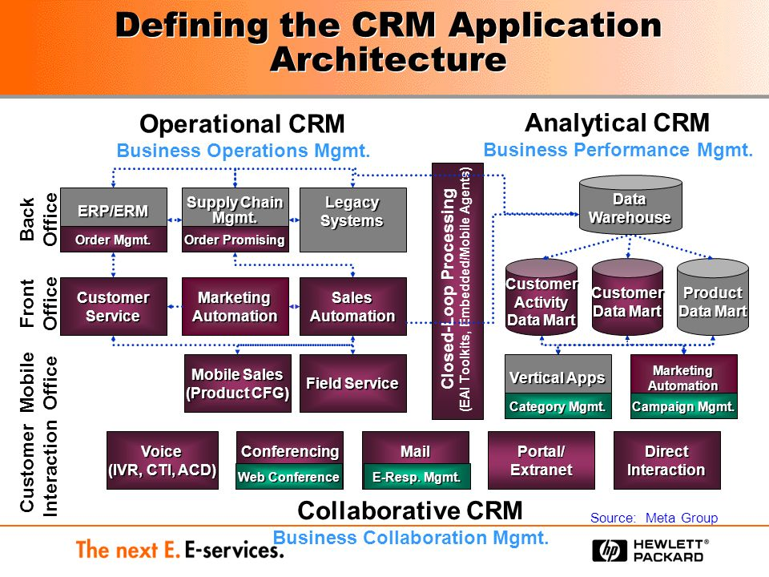
Overall Architecture.

Slide 5
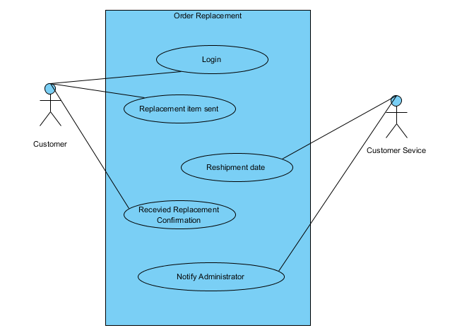
Use Case Diagram for Order Replacement.

Slide 6
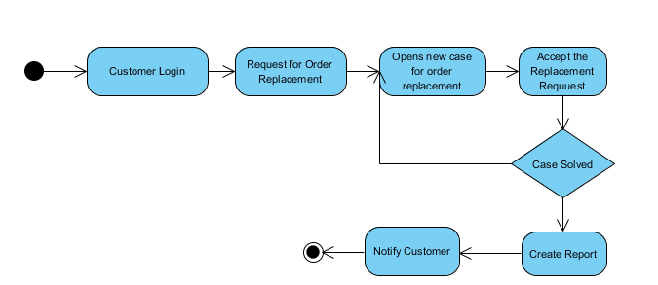
Work Flow Chart for the Use Case.
NO
YES

Slide 7
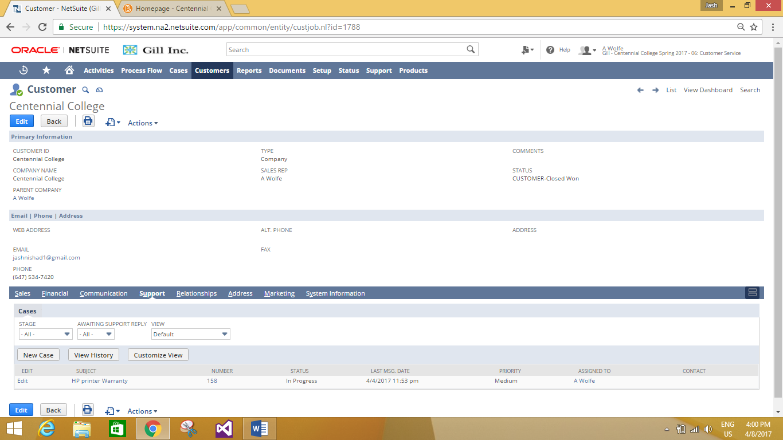
Navigate to Customer’s information page.

Slide 8
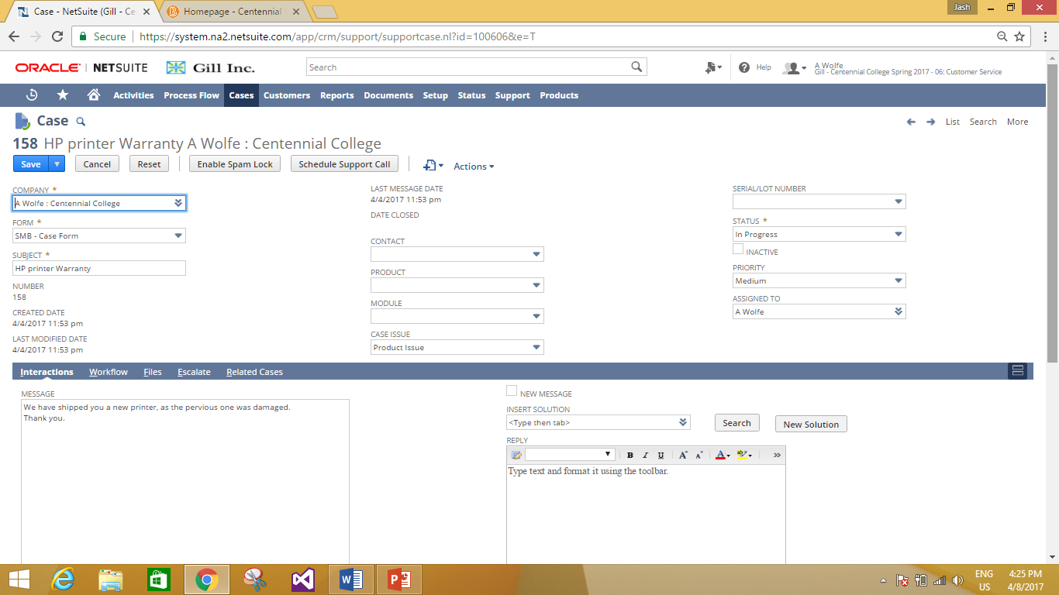
Creating case for customer’s order replacement.

Slide 9
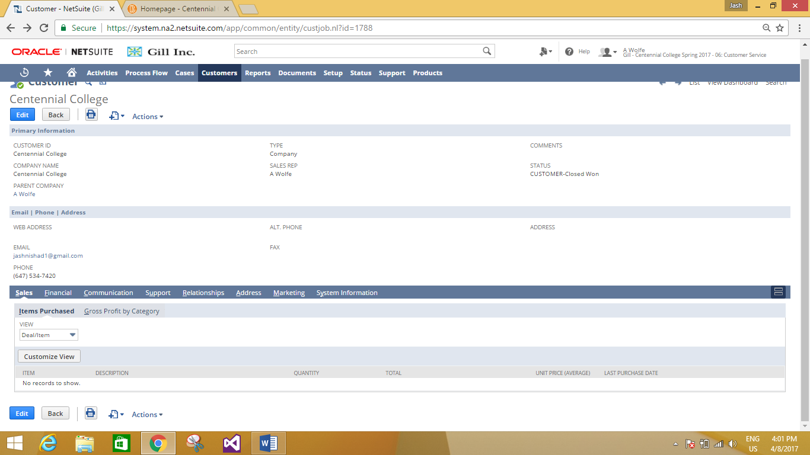
Customer’s Primary Information.

Slide 10

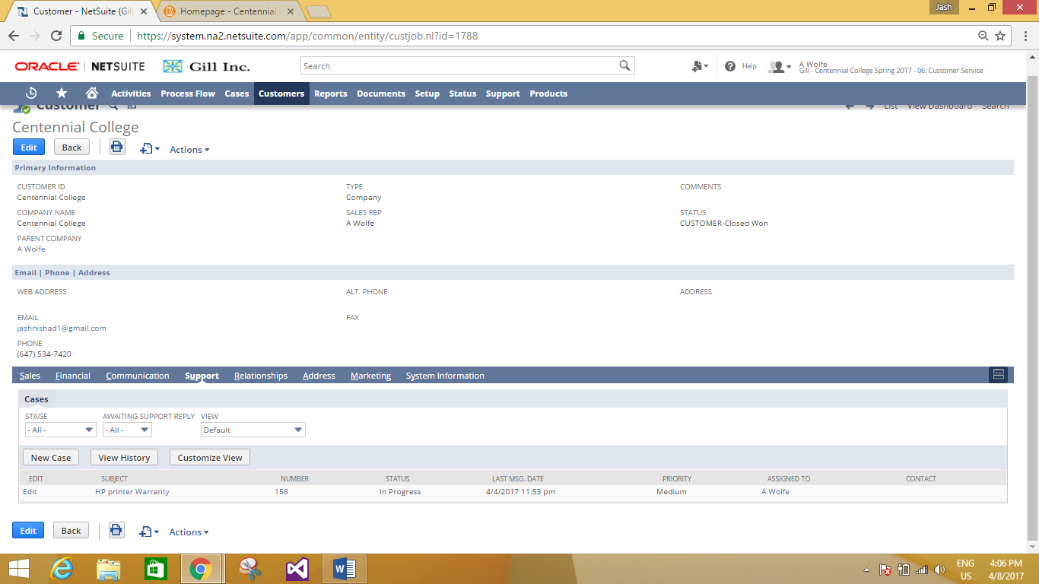
Navigate to Sales Information Tab
Navigate to Customer’s Support Tab

Slide 11
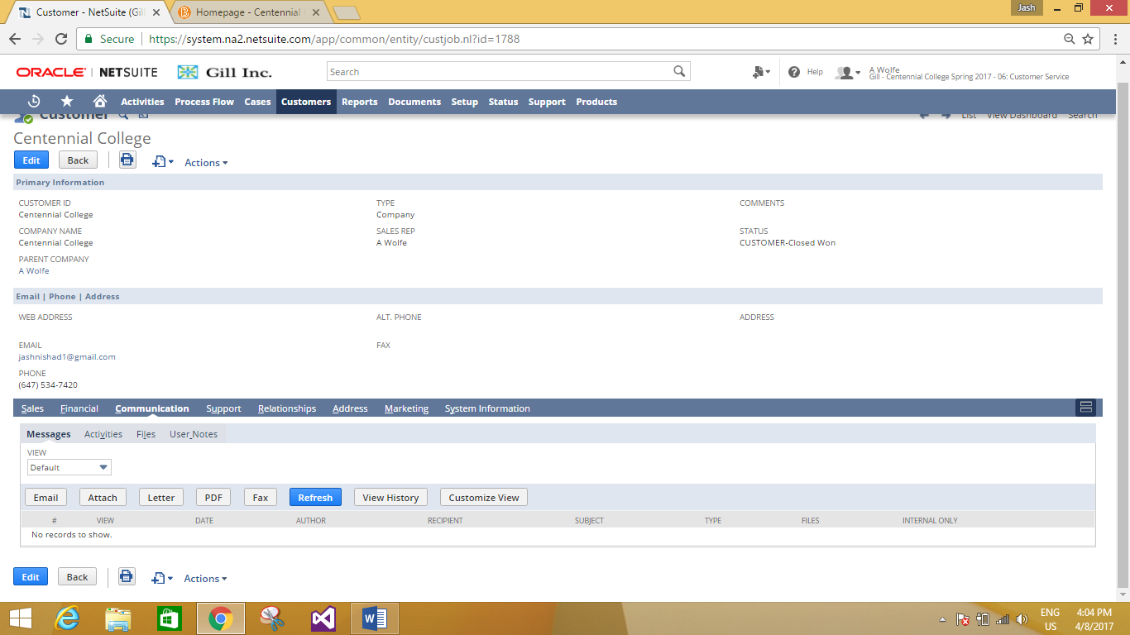
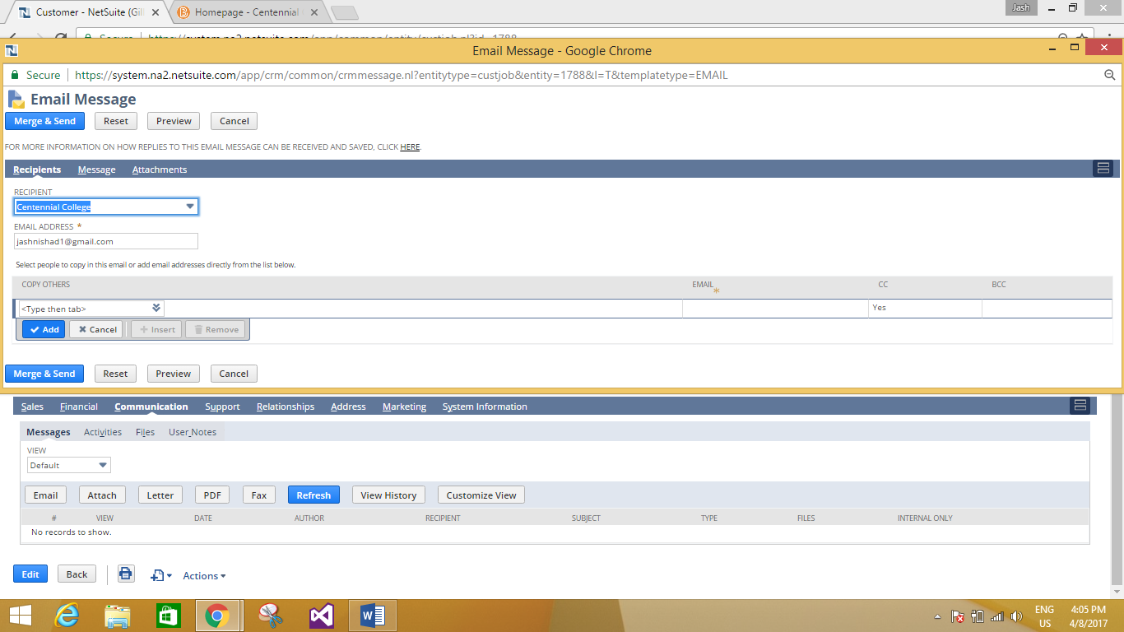
Navigate to Communication Tab
Example: Customer can be notified through e-mail.

Slide 12
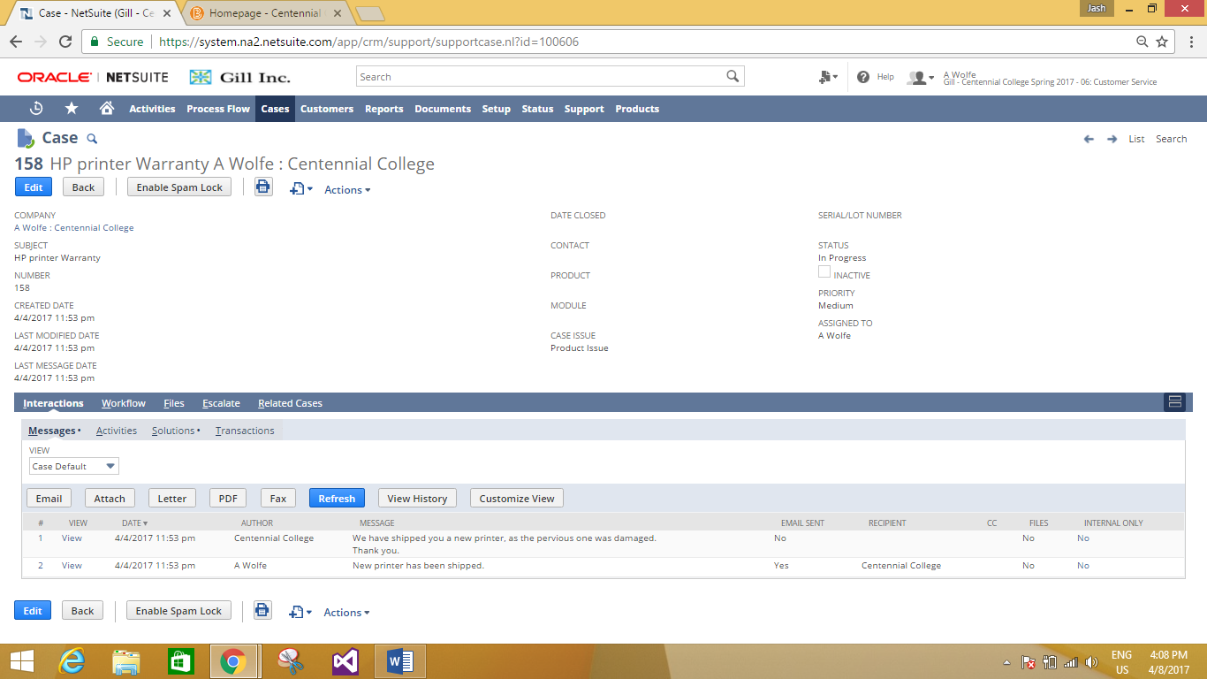
Complete Case Details.

Slide 13
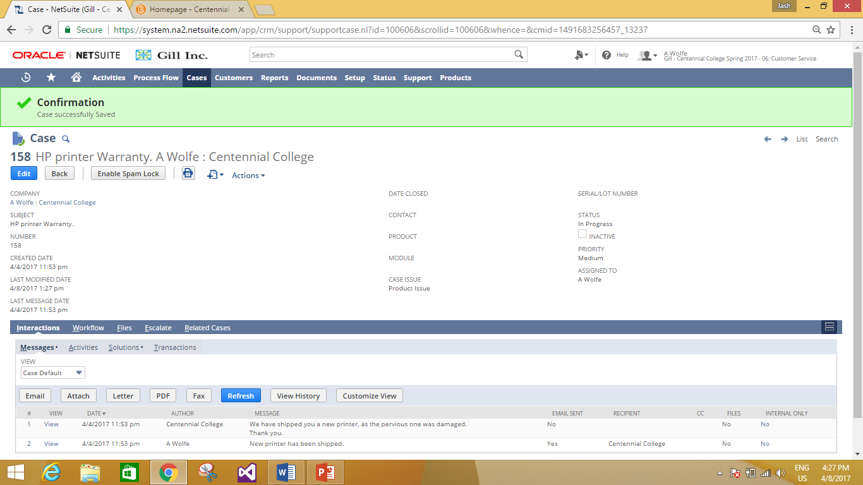
Case can be edited and Saved.

Slide 14
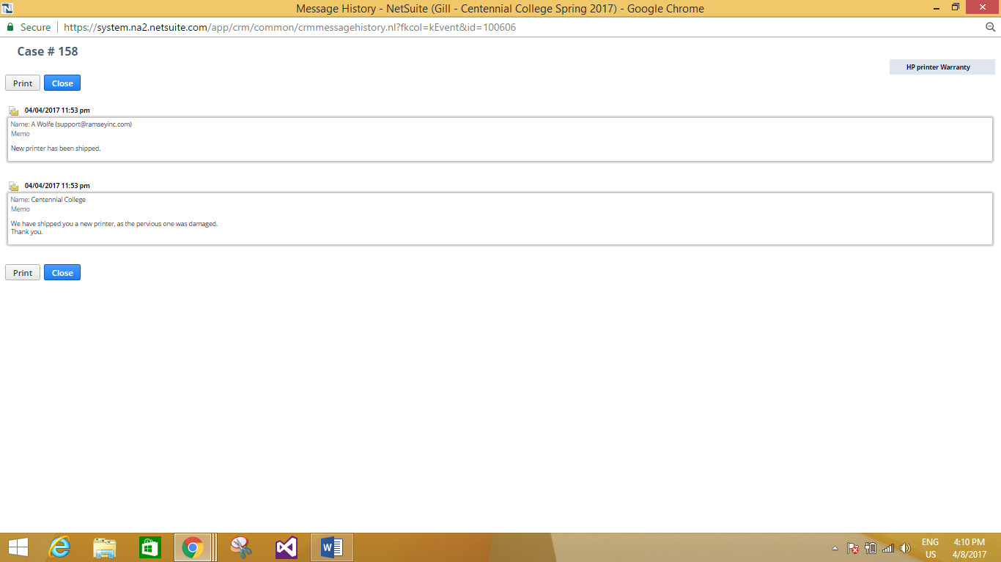
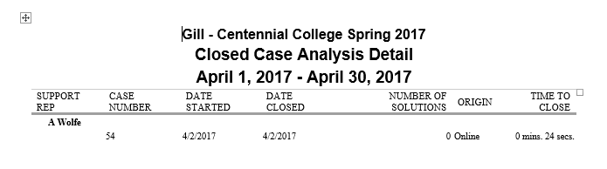
Message History of this Case.
Case Analysis Report.

Slide 15
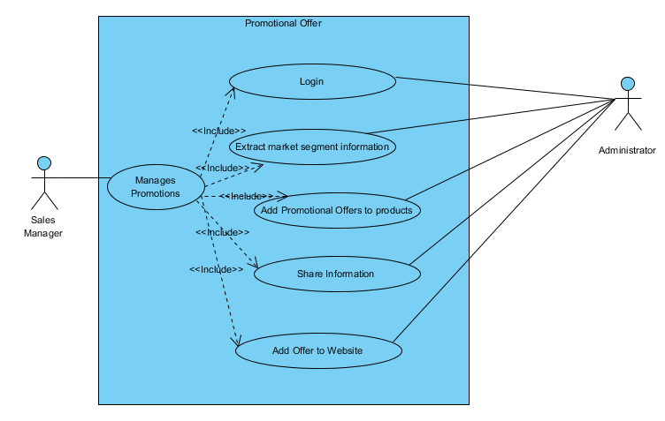
Use Case for Adding Promotional Offer.

Slide 16
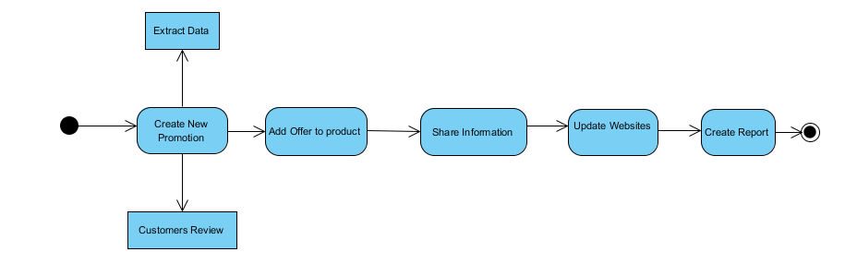
Work Flow Chart for the Use Case.

Slide 17
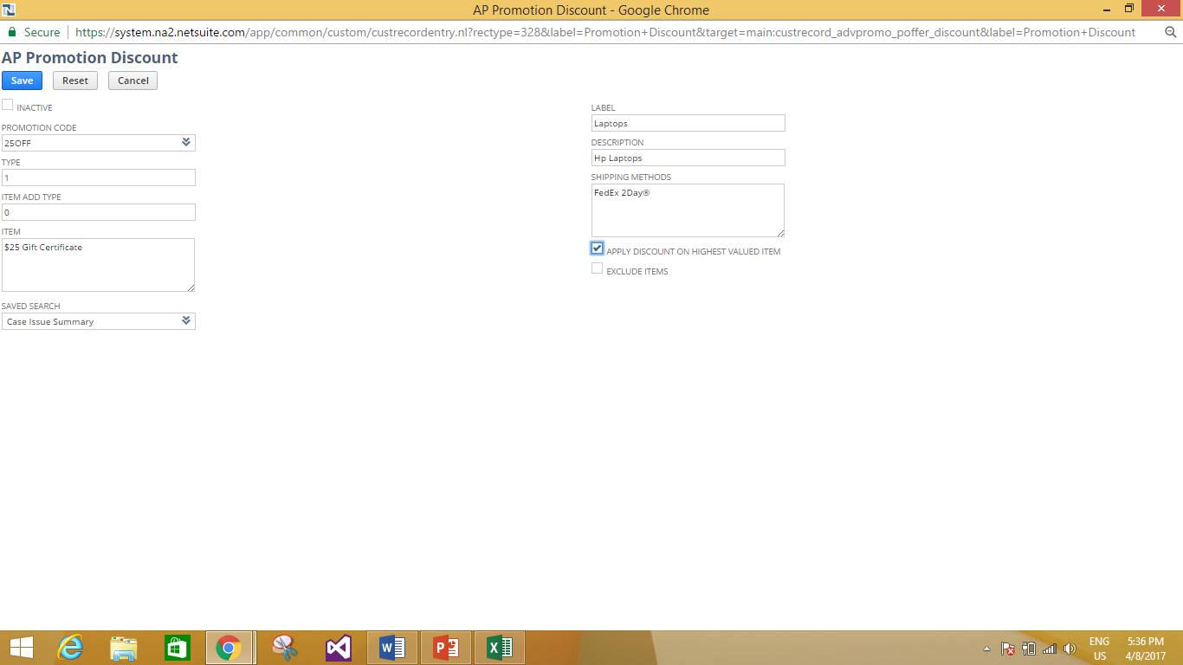
Adding Primary information for the promotional offer.

Slide 18
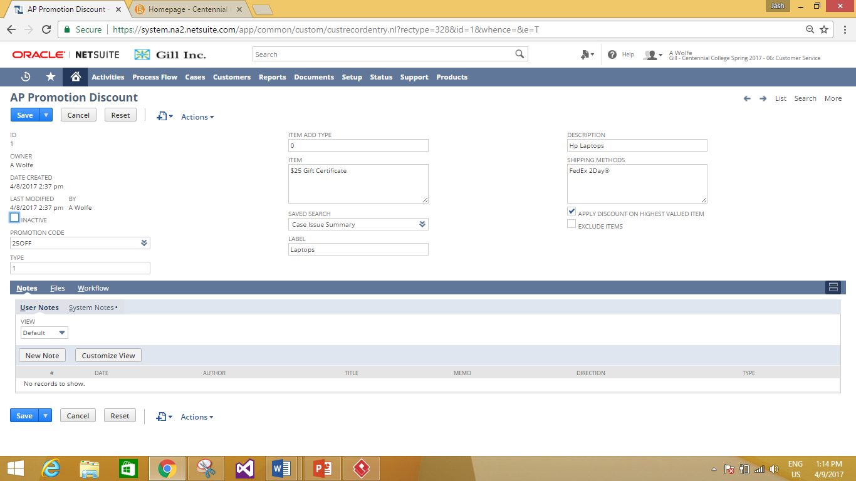
Adding Detailed Information.

Slide 19
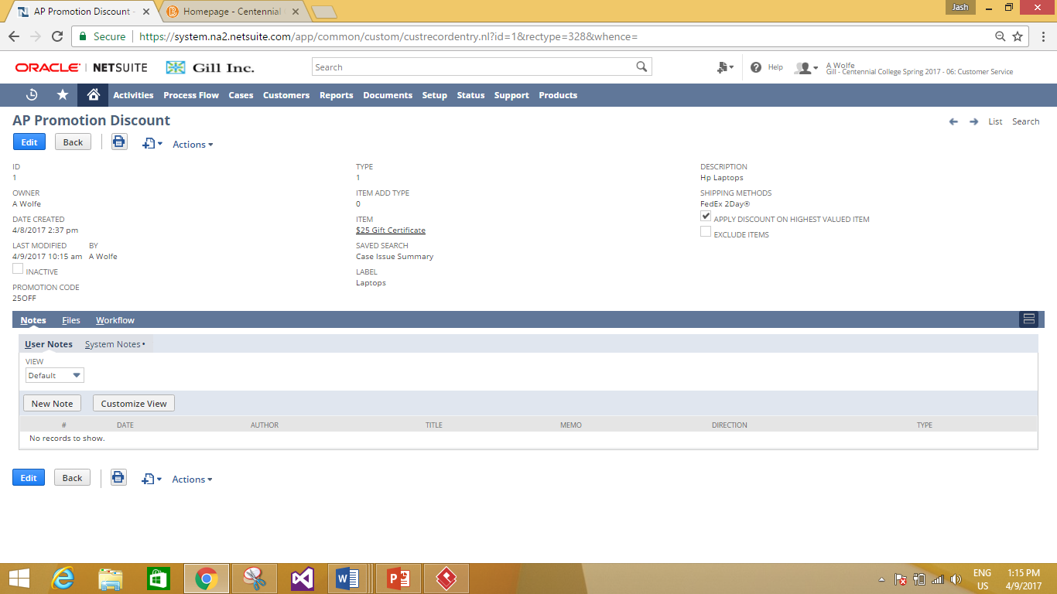
Detailed information Added and Saved

Slide 20
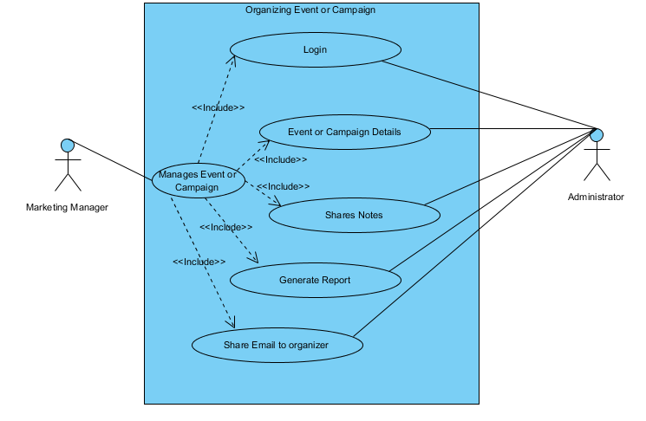
Use Case for Organizing an Event or Campaign.

Slide 21
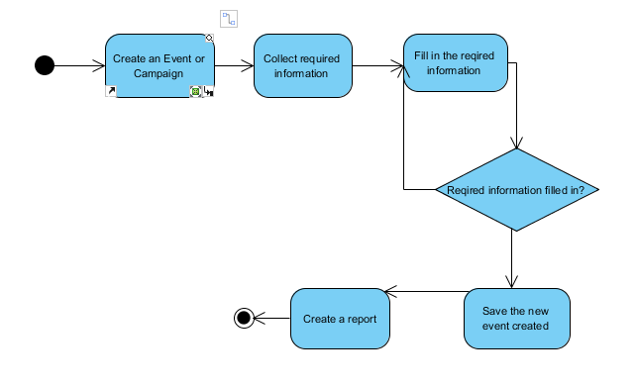
Work Flow Chart for
the Use Case.

Slide 22
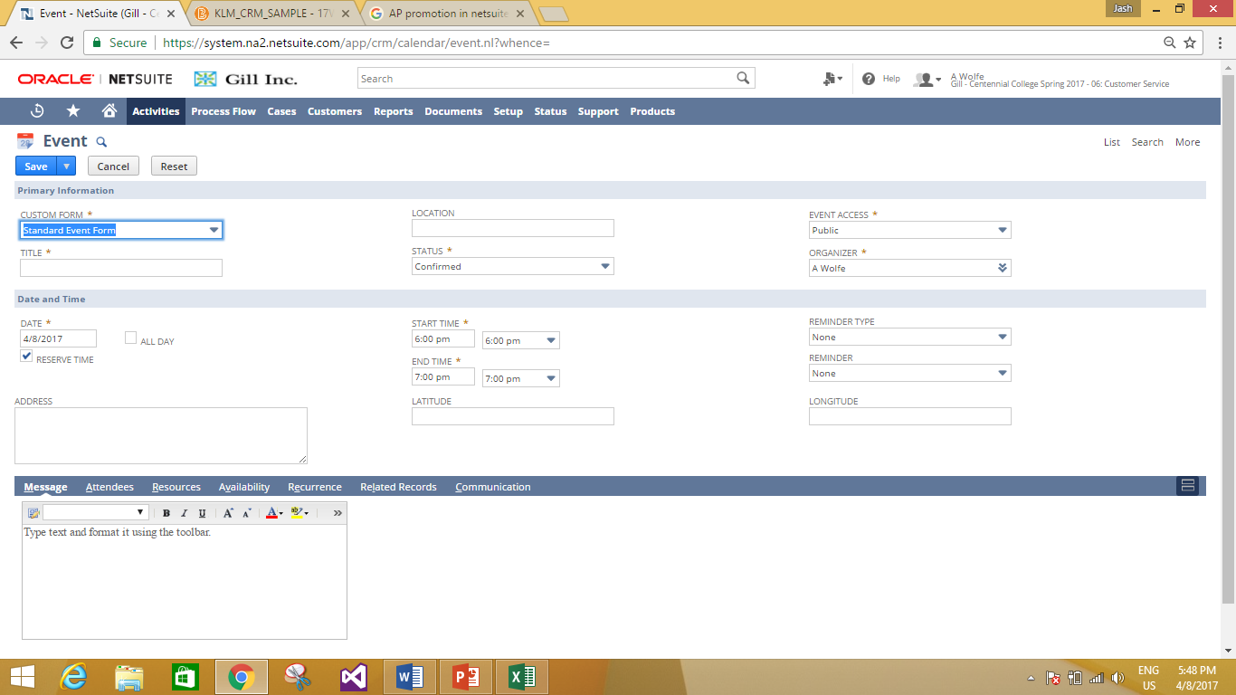
Creating an Activity (EVENT).

Slide 23
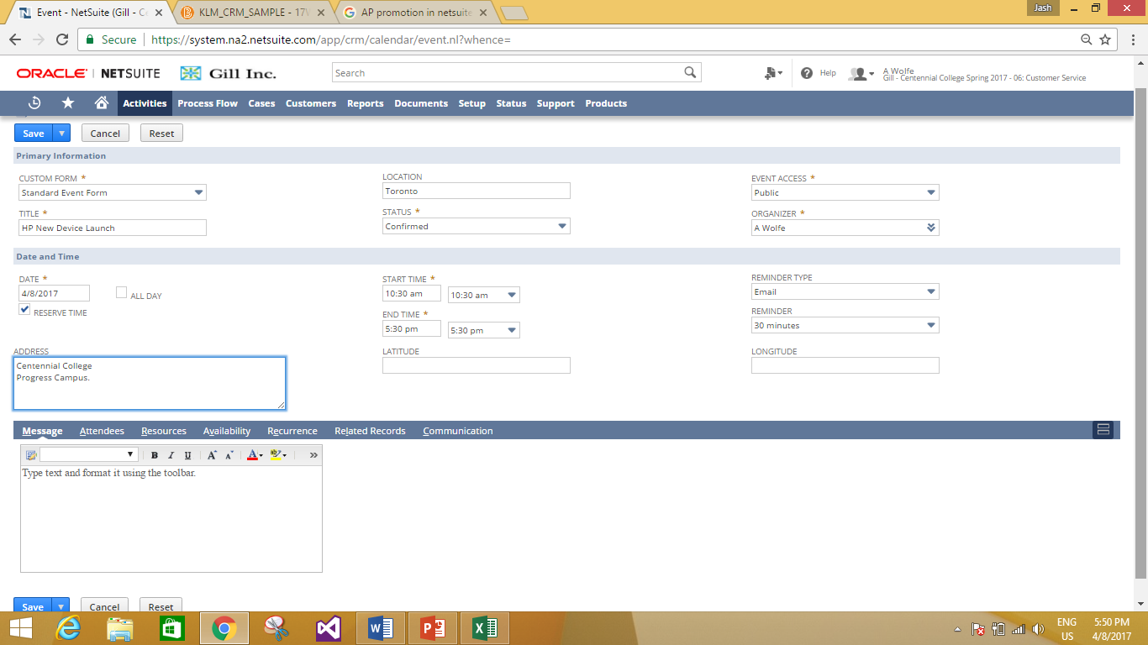
Fill in primary information for the Event.

Slide 24
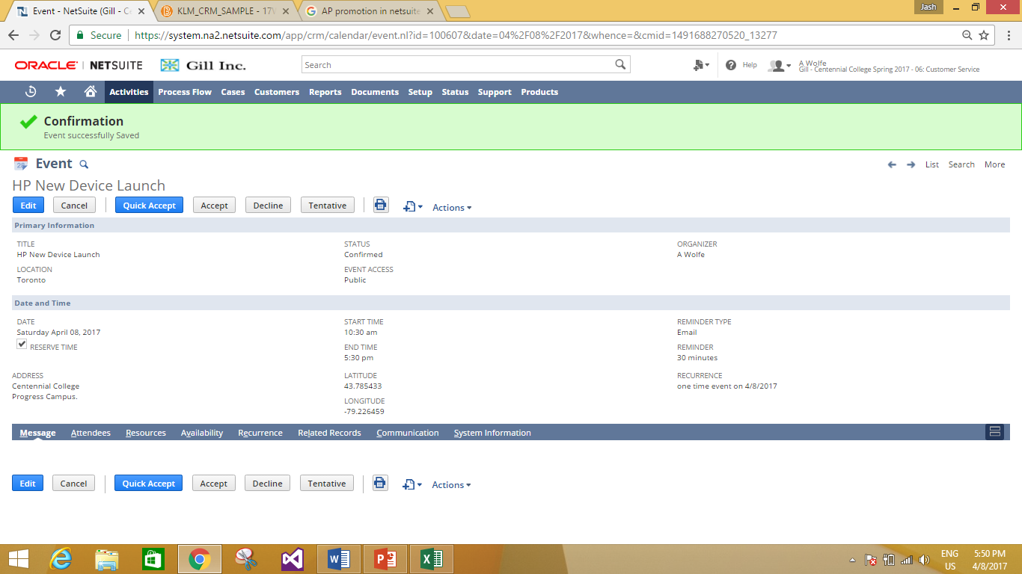
Fill in required information and save.

Slide 25
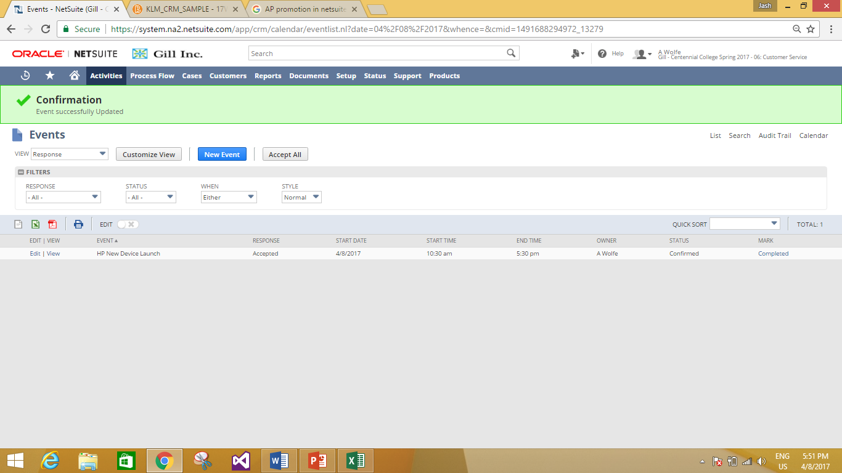
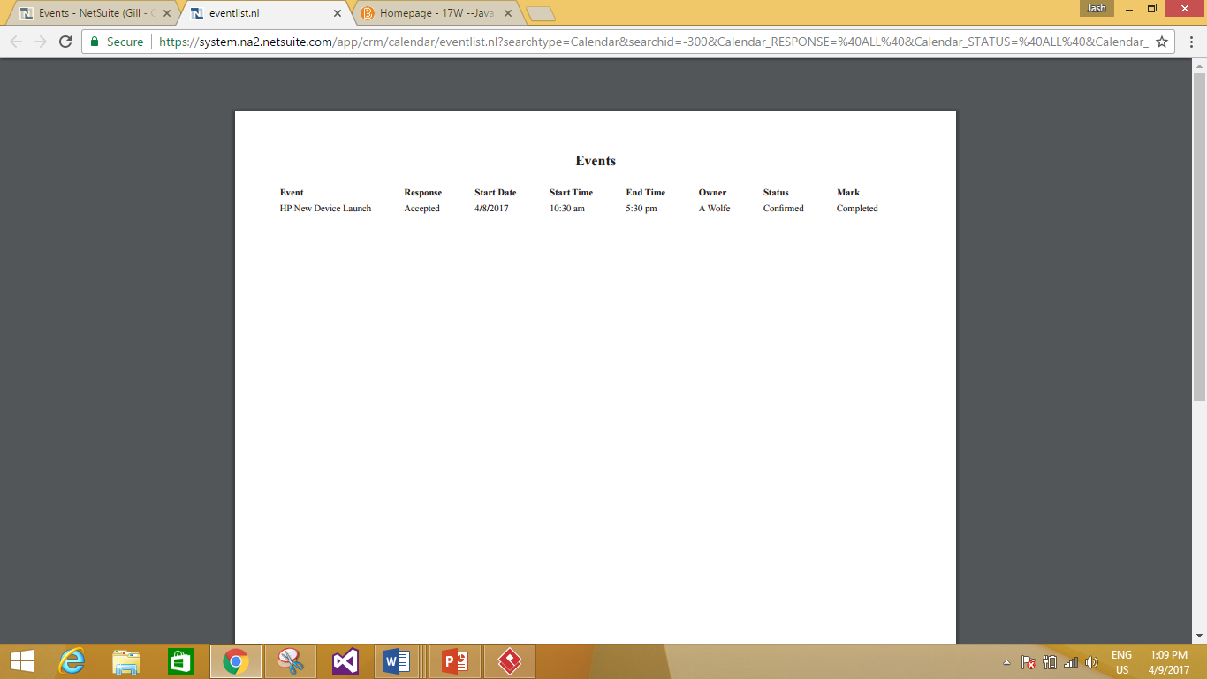
Updating Event.
Event Report.

Slide 26
References.
N. (n.d.). NetSuite CRM. Retrieved April 09, 2017, from http://www.netsuite.com/portal/products/crm.shtml
Hollar, K. (2016, July 07). Best CRM Software | 2017 Reviews of the Most Popular Systems. Retrieved April 09, 2017, from
http://www.capterra.com/customer-relationship-management-software/#infographic
Typo3 programming by bytes in motion, www.bytesinmotion.com. (2016, June 22). Microsoft Dynamics CRM: The features of Microsoft Dynamics CRM. Retrieved April 09, 2017, from
http://www.wuerth-phoenix.com/en/solutions/crm/microsoft-dynamics-crm/overview/

